Slide 1
Stress Management Techniques
Name
Course
Date

Slide 2
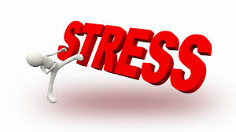
Introduction
This assignment will cover:
Two stress management techniques
Performance of each technique
How each technique works
Evaluation of each technique
Summary of findings
Notes:
The topics to be covered in this assignment include two stress management techniques, the performance of each technique, how each technique works, evaluation of each technique, and summary of findings. Under the stress management techniques topic, I will define each and provide an image representing each. Under the performance of each technique topic, I will explain how the techniques are performed and how often. Then, under the working of each technique topic, I will explain how they relieve stress and the effects they have on the body. The evaluation topic will include support information about whether each technique works or not, the opponents or proponents of each, strengths and weaknesses, and a personal opinion whether I would use the techniques. The summary topic will include the findings from this project.

Slide 3
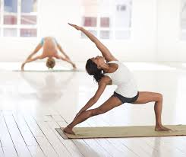

Stress Management Techniques
Some of the stress management techniques include;
  Regular exercise
  Eating a healthy diet
Regular exercise results in better sleep and improves mood.
A healthy diet reduces blood pressure and improves mood levels.
Notes:
Regular exercise is one of the most preferred techniques for managing stress. Notably, regular physical exercises, such as running, cycling, and swimming, are deemed essential for resulting in better sleep and improving mood levels (Holman et al., 2018). People who exercise regularly tend to be less anxious and are more optimistic about themselves. Consuming a healthy diet is essential not only for physical health but also for mental health. Conversely, a healthy diet lowers stress levels, blood pressure, and improves one's mood (DocMikeEvans, 2012).

Slide 4
Performance of Each Technique
Exercise techniques include;
  Running
  Cycling
  Swimming
A healthy diet involves basically consuming healthy foods and drinks.
Notes:
Regular exercises for managing stress may include various techniques, such as running, cycling, swimming, and dancing. The alternatives to the above techniques include walking during lunch break, using stairs rather than an elevator, hand-washing one's vehicle, and biking. There are various techniques for exercising, and therefore one may decide to exercise daily for better results. Basically, the performance of a healthy diet to manage stress involves ensuring that one's daily diet is composed of healthy foods and drinks. For example, stressed people should ensure that their daily diets have low quantities of sugar and fats (Holman et al., 2018).

Slide 5
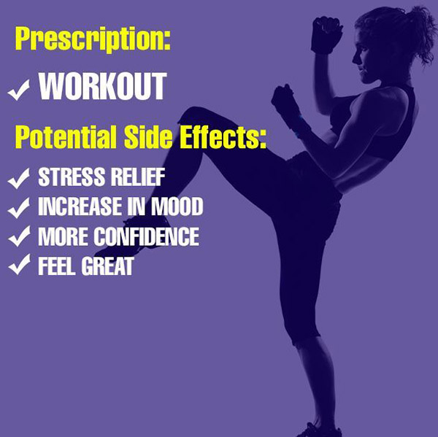
How Each Technique Works
Regular exercise stimulates the body to release useful hormones.
Exercise also reduces stress hormones, like adrenaline.
A healthy diet reduces blood pressure and improves the immune system.
Healthy foods also improve brain chemicals, such as serotonin.
Notes:
Regular exercises work by stimulating the body to produce useful hormones, such as endocannabinoids and endorphins (Yoga With Adriene, 2017). These hormones aid in sedation, improving sleep patterns and blocking pain, and this helps in the management of stress levels. Endorphins also act as the natural painkillers of the body as well as mood elevators. In addition, regular exercise helps the body to reduce hormones, like adrenaline associated with high levels of stress. Healthy diets, like oatmeal, are essential for boosting brain chemicals, such as serotonin. Serotonin helps the brain and body to calm. Healthy foods also cut stress hormones like cortisol and adrenaline. Moreover, a healthy diet enhances one's immune system and lowers blood pressure.

Slide 6
Evaluation of Exercise Technique
Regular exercise has been effective in reducing stress.
It enhances the quality of life and reduces anxiety as well as depression.
The American Heart Association supports this technique.
The American Psychological Association is also a proposer of this technique.
Notes:
Various organizations, such as the American Heart Association and the American Psychological Association, have recommended the use of regular exercises as an essential technique for managing stress. According to these organizations, regular exercises manage stress by reducing the level of blood pressure, enhancing the quality of sleep and mood levels, and helping people to control their body weight. The American Heart Association also hints that when people complete workouts, they have a feeling of good sensation and their well-being is overly improved. Chronic stress results in severe health conditions like hypertension and heart disease, and regular exercise is one of the strategies of managing these conditions (MedicineNet, 2017). Therefore, this technique is effective in managing stress.

Slide 7
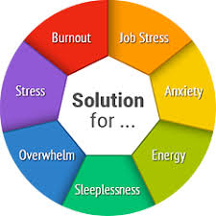
Evaluation of Exercise Technique
The strengths of this technique include;
  Improving the quality of sleep
  Lowering the risk of developing diseases like hypertension
  Reducing anxiety and depression
One of its weaknesses is that it may be tedious.
Personally, I would use this technique.
Notes:
Some of the strengths of regular exercise as a technique for managing stress include improving the quality of sleep, lowering the risk of developing diseases like hypertension, reducing anxiety and depression, and helping people to maintain healthy body weights. Regular exercise helps the body to prevent the release of stress hormones like adrenaline, and therefore people are likely to have peace of mind, get enough sleep and feel better about themselves (Stanford Health Care, 2018). One of the weaknesses of this technique is that some methods like cycling and running may be tiresome, and therefore not preferred by many people. Personally, I would use this technique because it would result in a wide range of benefits into my body and well-being in general.

Slide 8
Evaluation of Healthy Diet Technique
A healthy diet is effective in the management of stress.
The strengths of this technique include;
  Reducing blood pressure
  Improving the immune system
One of its weaknesses is that healthy foods may be expensive.
Personally, I would use this technique.
Notes:
Various learning institutions, such as the Edison Institute of Nutrition and the University of Michigan, have recommended the use of a healthy diet as one of the best techniques to manage stress. According to these institutions, this technique has several benefits, including reducing the level of blood pressure, improving mood levels, and enhancing the immune system. Chronic stress may result in the development of health conditions like hypertension, and therefore having a strong immune system is essential in managing such conditions (Stanford Health Care, 2018). One of the weaknesses of this technique is that healthy foods are expensive and therefore not affordable to everyone, especially to individuals from low-income family backgrounds. Personally, I would use this technique because it is an effective tool for managing stress.

Slide 9
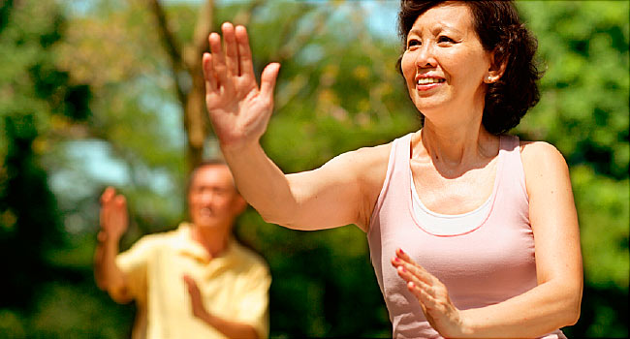
Conclusion
Regular exercise and healthy diets are essential techniques for stress management.
Regular exercise results in quality sleep and reduces anxiety and depression.
A healthy diet helps in the reduction of blood pressure and improvement of the immune system.
Generally, stress management is essential for a better quality of life.
Notes:
In summation, regular exercise and healthy diets are essential techniques for stress management because they result in wide benefits. Regular exercise results in quality sleep and reduces anxiety and depression. A healthy diet helps in the reduction of blood pressure and improvement of the immune system. Generally, stress management is essential for a better quality of life.

Slide 10
References
DocMikeEvans. (2012, June 09). 90:10 The Single Most Important Thing You Can Do For Your Stress. YouTube. Retrieved October 02, 2017, from https://www.youtube.com/watch?v=I6402QJp52M
Holman, D., Johnson, S., & O'Connor, E. (2018). Stress management interventions: Improving subjective psychological well-being in the workplace. Handbook of well-being. Salt Lake City, UT: DEF Publishers. DOI: nobascholar. com.
MedicineNet. (October 02, 2017). Endorphins: Natural Pain and Stress Fighters (n.d.). Retrieved from http://www.medicinenet.com/script/main/art.asp?articlekey=55001
Stanford Health Care. (2018). Beyond Stress and Anxiety: How Stress Affects the Body and What You Can Do to Manage It. YouTube. Retrieved from https://www.youtube.com/watch?v=M6ZmTKQyVOE
Yoga With Adriene. (2017). Yoga for Anxiety and Stress. YouTube. Retrieved from https://www.youtube.com/watch?v=hJbRpHZr_d0

